Slide 1
Digital Watermarking

Slide 2
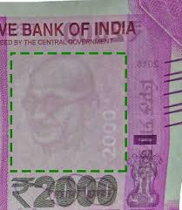
What is a watermark ?
What is a watermark ? A distinguishing mark impressed on paper during manufacture; visible when paper is held up to the light (e.g. Rs. 2000 note)
Application for print media → authenticity of print media

Slide 3
What is a watermark ?
Digital Watermarking: Application of Information hiding (Hiding Watermarks in digital Media, such as images, text, audio, video.)
Digital Watermarking can be ?
- Perceptible (e.g. author information in .doc)
- Imperceptible (e.g. author information in images)

Slide 4
Cryptography vs Steganography
Cryptography
hides content of a secret message from malicious people
Steganography
conceal the existence of the message
Digital Watermarking
hides the copyright information into the digital data through certain algorithm

Slide 5
Applications
Broadcast Monitoring:
It is often crucially important that we are able to track when a specific video is being broadcast by a TV station. This is important to advertising agencies that want to ensure that their commercials are getting the air time they paid for. Watermarking can be used for this purpose

Slide 6
Applications
Transaction tracking :
Transaction tracking is another interesting application of watermarking. In this case the watermark embedded in a digital work can be used to record one or more transactions taking place in the history of a copy of this work.

Slide 7
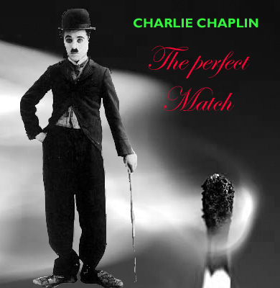
Applications
Copyright Protecton:To prove the ownership
of digital media
Eg. Cut paste of images
Hidden Watermarks represent the copyright information

Slide 8

Applications
Tamper proofing: To find out if data was tampered.
Eg. Change meaning of images
Hidden Watermarks track change in meaning
Issues: Accuracy of detection

Slide 9
Applications
Copy Control and fingerprinting:
Issue is similar to transaction tracking of the content. An owner embed a watermark into digital content that identifies the buyer of the copy. If unauthorized copies are found later, the owner can trace the origin of the illegal copies.

Slide 10
Watermark properties
Effectiveness
Image Infidelity
Payload size
False positive rate
Robustness

Slide 11
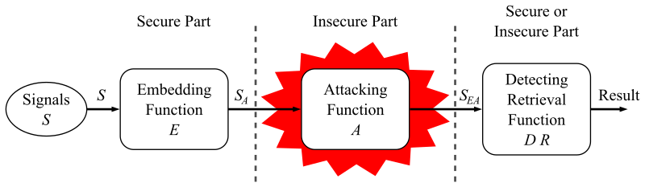
Digital watermarking life-cycle phases
A watermarking system is usually divided into three distinct steps, embedding, attack, and detection.

Slide 12
Embedding
In embedding, an algorithm accepts the host and the data to be embedded, and produces a watermarked signal.
Then the watermarked digital signal is transmitted or stored, usually transmitted to another person.

Slide 13
Attack
If this person makes a modification, this is called an attack. While the modification may not be malicious, the term attack arises from copyright protection application, where third parties may attempt to remove the digital watermark through modification. There are many possible modifications, for example, lossy compression of the data (in which resolution is diminished), cropping an image or video, or intentionally adding noise.

Slide 14
Detection or Extraction
Detection (often called extraction) is an algorithm which is applied to the attacked signal to attempt to extract the watermark from it. If the signal was unmodified during transmission, then the watermark still is present and it may be extracted.
In robust digital watermarking applications, the extraction algorithm should be able to produce the watermark correctly, even if the modifications were strong. In fragile digital watermarking, the extraction algorithm should fail if any change is made to the signal.

Slide 15
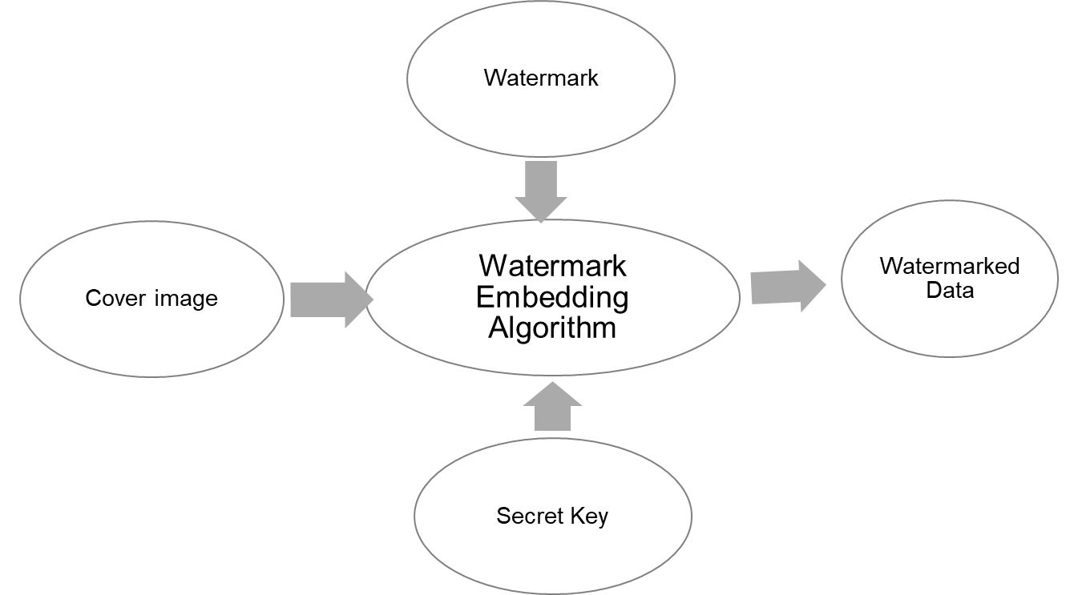
Watermarking Embedding Process

Slide 16
Embedding Algorithm
Let:
f() denote the embedding function,
I the original watermark,
W the watermark to be embedded,
watermarked image, I’ can be expressed as:
I=f(I,W)

Slide 17
Embedding Algorithm
Common approach is as follows:
Extract a property sequence from original image V = v1, v2… vn, corresponding watermark sequence is X = x1, x2… xn.
Embed X into V according to certain model to obtain the adjusted sequence V’ = V + X = v’1, v’2…v’n.
Put V’ back and take the place of V , then we get the watermarked image I’.

Slide 18
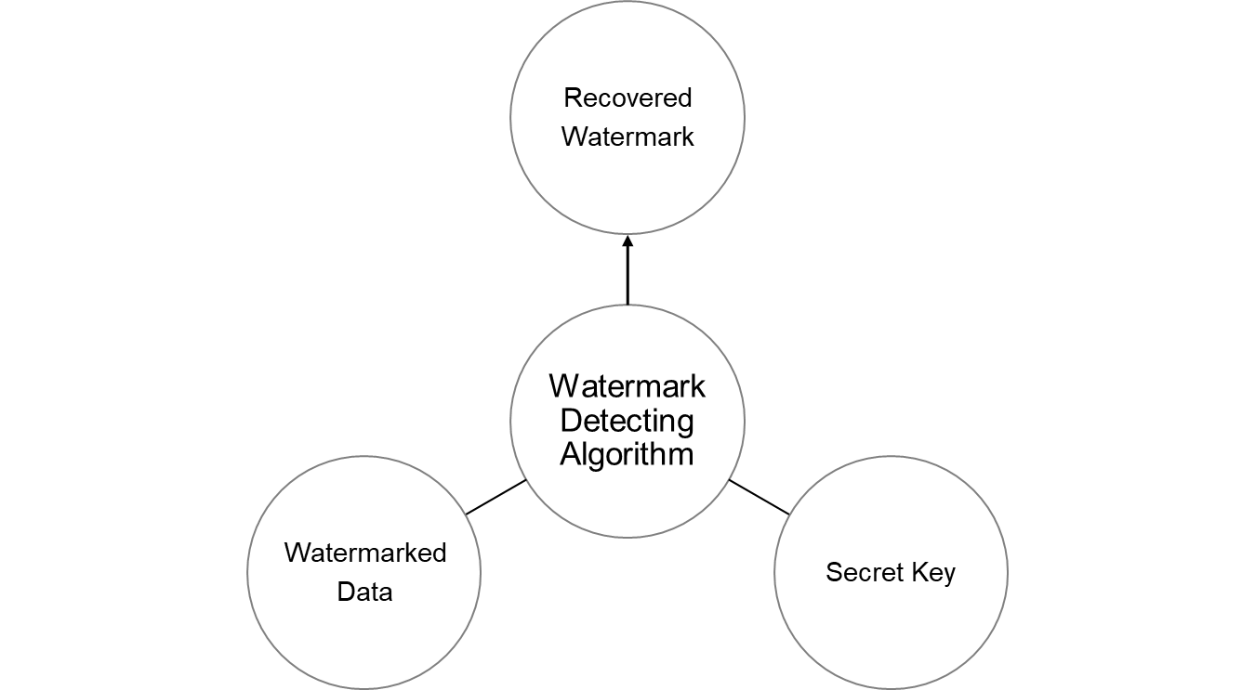
Watermark Detection Process

Slide 19
Detection Algorithm
Let
E() denote the detection function and
I’ the image to be examined.
Extract the watermark from I’
W’=E(I’) Blind-extracting watermarking or,
W=E(I’,I) Nonblind-extracting watermarking
If the correlation function C(W, W’) satisfies:-
C(W,W’)>=T (T is the threshold value)
then, we consider there is a watermark W in I’. Otherwise there is none.

Slide 20
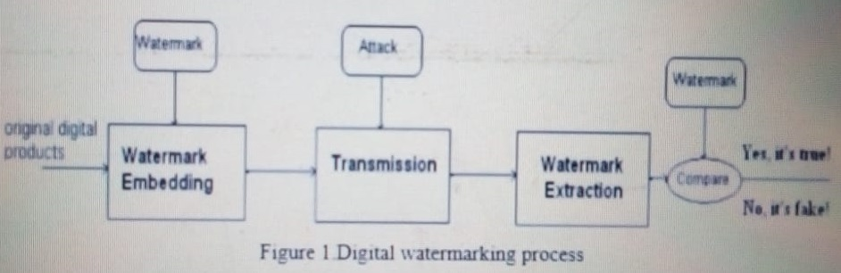
Watermarking Process
The whole process can be seen in figure 1:-

Slide 21
Data Domain Categorization
Spatial Watermarking
Direct usage of data to embed and extract Watermark
e.g. voltage values for audio data
Transform Based Watermarking
Conversion of data to another format to embed and extract.
e.g. Conversion to polar co-ordinate systems of 3D models, makes it robust against scaling

Slide 22
Methods of Spatial Domain
Least Significant Bit(LSB)
Additive Watermarking
SSM Modulation Based Technique
Texture mapping coding Technique
Patchwork Algorithm
Correlation-Based Technique

Slide 23
Least Significant Bit
Convert RGB image to grey scale image.
Make double precision for image.
Shift most significant bits to low significant bits of watermark image.
Make least significant bits of host image zero.
Add shifted version (step 3) of watermarked image to modified (step 4) host image.
Advantages:
Easy, provide high perceptual transparency no image degradation.
Disadvantages:
poor robustness

Slide 24
Patchwork Algorithm
Patchwork is a data hiding technique developed by Bender et al and published on IBM Systems Journal, 1996. It is based on a pseudorandom, statistical model. Patchwork imperceptibly inserts a watermark with a particular statistic using a Gaussian distribution. A pseudo randomly selection of two patches is carried out where the first one is A and the second is B. Patch A image data is brightened where as that of patch B is darkened (for purposes of this illustration this is magnified).
Advantages:
High level of robustness against most type of attacks.
Disadvantages:
It can hide only a very small amount of information.

Slide 25
Methods of Frequency domain:
Discrete cosine transforms (DCT)
Discrete wavelet transforms (DWT)
Discrete Fourier transform (DFT)

Slide 26
Discrete cosine transforms (DCT)
Steps in DCT Block Based Watermarking Algorithm
Segment the image into non-overlapping blocks of 8x8
Apply forward DCT to each of these blocks
Apply some block selection criteria (e.g. HVS)
Apply coefficient selection criteria (e.g. highest)
Embed watermark by modifying the selected coefficients.
Apply inverse DCT transform on each block.
Advantages:
The watermark is embedded into the coefficients of the middle frequency, so the visibility of image will not get affected and the watermark will not be removed by any kind of attack.

Slide 27
Discrete wavelet transforms (DWT)
Wavelet Transform is a modern technique frequently used in digital image processing, compression, watermarking etc.
The transforms are based on small waves, called wavelet, of varying frequency and limited duration.
The wavelet transform decomposes the image into three spatial directions, i.e. horizontal, vertical and diagonal.
Hence wavelets reflect the anisotropic properties of HVS more precisely. Magnitude of DWT coefficients is larger in the lowest bands (LL) at each level of decomposition and is smaller for other bands (HH, LH, and HL).
The Discrete Wavelet Transform (DWT) is currently used in a wide variety of signal processing applications, such as in audio and video compression, removal of noise in audio, and the simulation of wireless antenna distribution.
Disadvantages:
Cost of computing may be higher, longer compression time, Noise/blur near edges of images or video frames
Advantages:
Allows good localization both in time and spatial frequency domain , higher compression ratio which is relevant to human perception.

Slide 28
Advantages of DWT over DCT
Wavelet transform understands the HVS more closely than the DCT. Wavelet coded image is a multi-resolution description of image. Hence an image can be shown at different levels of resolution and can be sequentially processed from low resolution to high resolution.

Slide 29
Discrete Fourier transform (DFT)
Transforms a continuous function into its frequency components. It has robustness against geometric attacks like rotation, scaling, cropping, translation etc. DFT shows translation invariance. Spatial shifts in the image affects the phase representation of the image but not the magnitude representation, or circular shifts in the spatial domain don't affect the magnitude of the Fourier transform.
Advantages:
DFT is rotation, scaling and translation (RST) invariant. Hence it can be used to recover from geometric distortions.
Disadvantages:
Complex implementation
Cost of computing may be higher.

Slide 30
Disadvantages of DWT over DCT
Wavelet transform understands the HVS more closely than the DCT. Wavelet coded image is a multi-resolution description of image. Hence an image can be shown at different levels of resolution and can be sequentially processed from low resolution to high resolution.

Slide 31
Advantages of DFT over DWT and DCT
DFT is rotation, scaling and translation (RST) invariant. Hence it can be used to recover from geometric distortions, whereas the spatial domain, DCT and the DWT are not RST invariant and hence it is difficult to overcome from geometric distortions.

Slide 32
THANK YOU

Slide 33
References
http://en.wikipedia.org/wiki/Steganography
http://en.wikipedia.org/wiki/Digital_watermark
http://www.cypak.com/pictures/med/Cypak%20microchip.jpg
https://ijcat.com/archives/volume5/issue3/ijcatr05031006.pdf
THANK YOU !

